Slide 1
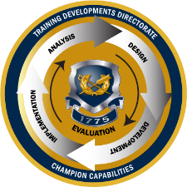
TJAGLCS Training Package
Pretrial Confinement
December 2024

Slide 2
The information provided throughout this training aid does not, and is not intended to, constitute legal advice; instead, all information, laws, statues, content, and materials for this training aid are for general informational purposes only. This training aid may not constitute the most up-to-date legal or other relevant legal information. Judge Advocates need to conduct their own due diligence through independent further legal research on any specific legal issue contained in this training package. No reader, user, or trainee of this product should act or refrain from acting based on information from this training aid without first seeking legal advice from an attorney in the relevant jurisdiction.

Slide 3
Pretrial Confinement

Slide 4
References
UCMJ, Articles 6b.,7, 9, 10, 13
R.C.M. 302, 304, 305
Criminal Law Online Deskbook, Chapter 7
AR 27-10 (20 April 2024)
Notes:
Art 7 = Apprehension
Article 9 = Restraint
Article 10 = arrest
Article 13 = prohibition on pre-trial punishment
RCM 302 = apprehension
RCM 304 = PTR
RCM 305 = PTC

Slide 5
Learning Objectives
Understand purpose and procedural requirements for pretrial confinement and restraint.
Recognize impacts of PTC on an accused, the command, victims, and counsel.
Analyze facts and accurately advice on potential restrictions taking into consideration legal consequences of the imposition of PTC or PTR.

Slide 6
APPEAL
Pretrial Confinement Spans Entire MJ Process
ENTRY OF JUDGMENT/CONVENING AUTHORITY ACTION
Pretrial restraint can affect case disposition.
MOTIONS
MERITS
SENTENCING
POST-TRIAL
GENERAL OR SPECIAL COURT-MARTIAL
Allegation
Most likely arise here
ARRAIGNMENT
SERVICE ON THE ACCUSED
REFERRAL
SUMMARY
COURT-MARTIAL
GCMCA
Higher HQs
SPCMCA
DIVISION
SCMCA
ART 32
INVESTIGATION
BRIGADE
BATTALION
PREFERRAL
COMPANY
Office of the Special Trial Counsel
ARTICLE 15
ADMINISTRATIVE ACTION
ADVERSE PERSONNEL ACTION
DISMISS CHARGES
NO ACTION
ALTERNATIVE DISPOSITION
Notes:
Put this block into context: will cover 3 topics in 3 hours…pretrial restraint and confinement, speedy trial, sentence credit
Topics seem random but they all tend to flow into each other
Span from the initial investigation of the crime, all the way to sentencing
PTR/PTC will most likely come up during the period between the crime and preferral, in the investigation phase…could also come up later
Speedy trial considers whether they GOV brought the Accused to trial fast enough and runs from the triggering event (generally PTC or preferral) all the way to trial (generally arraignment)
Sentence credit applies at the sentencing phase and allows the MJ to give the Accused credit for all the things that happened before
Speedy trial significance: speedy trial is something TC and DC need to think about in EVERY CM because one or more sources will always apply, but should rarely be an issue if TC does their job right
Not uncommon for cases to be dismissed without prejudice (and less often with prejudice) due to speedy trial clock violations
Very embarrassing for TC if case is dismissed (command, SJA, victims will all be irate)
Very lucrative opportunity for DC to better situate their client with a dismissal

Slide 7
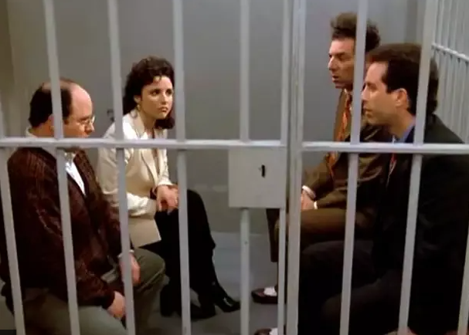
Pretrial Confinement
Pretrial Confinement is physical restraint, imposed by order of competent authority, depriving a person of freedom pending disposition of charges.
Has significant procedural requirements, is command resource intensive, and triggers heightened OSJA and judicial scrutiny.
PRACTICE TIP: Remember Speedy Trial (RCM 707(a)(2) &
Article 10, UCMJ
R.C.M. 305(a)

Slide 8
The PTC Process
SJA notified/ concurs
Trained escorts Identified
TDS counsel assigned
72-hour CDR’s review
Command visits
CDR wants to impose PTC
PTC Docs
Drafted
Charge sheet drafted
48-hour PC review
7-day MM review
A commander can order any person subject to trial by CM into PTC. RCM 305(b).
Must establish by Probable Cause that:
Offense was committed;
the accused committed it;
confinement is necessary to ensure the accused appears or does not commit serious criminal misconduct; &
less severe forms of restraint are inadequate. RCM 305(i)(2)(B)(i-iv).
Notes:
QUESTION: Should any old commissioned officer order PTC of a Soldier he doesn’t command? NO! What would TJAGLCS CG have to say if I ordered his CSM into PTC?
Although rule states any officer can order confinement of a Soldier, it really should be ordered by the commander of the Soldier as a practical matter…never a good day when a CPT finds out a 2LT ordered his Soldier into PTC
Also, check the local 27-10 supplement because it probably withholds authority to order a Soldier into PTC to the Soldier’s CDR
If CDR did not order PTC, whoever took the SM into PTC (PMO station, etc.) must inform CDR w/i 24 hours (RCM 305(h)(1))
Article 10 and discussion to RCM 305(d) both state that an Accused charged with an offense normally triable by SCM should ordinarily not go to PTC
Local 27-10 supplements may make this a hard rule
One of the requirements to impose PTC is that it is required UTC to ensure Accused appears at next hearing, trial, etc., or to ensure Accused does not commit serious criminal misconduct
QUESTION: What is good evidence that an accused may not appear for trial/hearing/etc.? Repeated AWOL…they say they are going to flee…they have been selling/getting rid of all their gear…etc.
QUESTION: How would you define serious criminal misconduct? Intimidation of witnesses or other obstruction of justice; Serious injury of others; Offenses which pose a serious threat to the safety of the community or to the effectiveness, morale, discipline, readiness, or safety of the command, or to the national security of the United States
When considering if requirements have been met, person ordering confinement should consider factors in old RCM 305(h)(2)(B) discussion
QUESTION: What do you think are some of the factors the commander should consider before ordering PTC? Open discussion of old RCM 305(h)(2)(B) and see what it includes…
Nature and circumstances of the offense
Weight of evidence against Accused
Accused’s ties to the duty station (family, off-duty employment, financial resources, etc.)
Character and mental condition
Service record (including previous misconduct)
Record of appearance/flight from other proceedings
Likelihood Accused can/will commit further serious misconduct
Persons who can order release from PTC: any commander (immediate, higher, commander of installation on which confinement facility is located), any person conducting a 48-hr or 72-hr review, MM, MJ

Slide 9
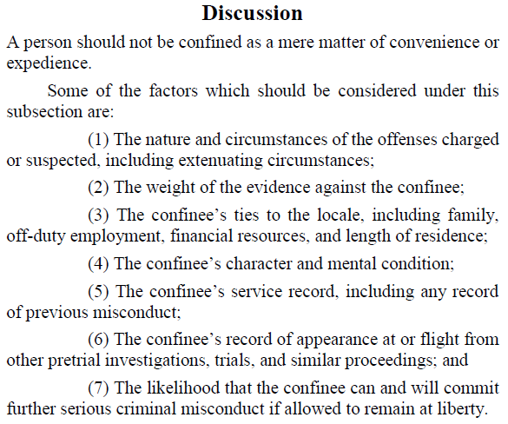
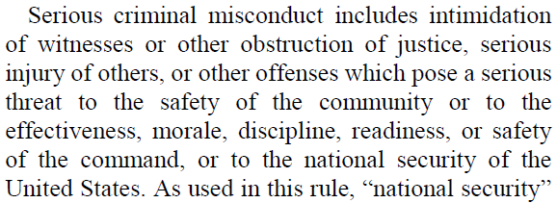
Serious Criminal Misconduct?
See R.C.M. 305(i)(2)(B)

Slide 10
The PTC Process
SJA notified/ concurs
Trained escorts Identified
TDS counsel assigned
72-hour CDR’s review
Command visits
CDR wants to impose PTC
PTC Docs
Drafted
Charge sheet drafted
48-hour PC review
7-day MM review
SJA must be notified before imposition of PTC or ASAP thereafter
AR 27-10, para. 5-21
If the person is alleged to have committed an OSTC covered offense is ordered into or released Special Trial Counsel shall be notified immediately RCM 305(f)
Notes:
Note that your installation’s local 27-10 supplement may have more stringent requirements, like a SJA consent requirement
Example is the 82d ABN DIV 27-10 supplement shown, which requires concurrence of the SJA before someone is put in PTC
Added updates to the rule to reflect OSTC notification

Slide 12
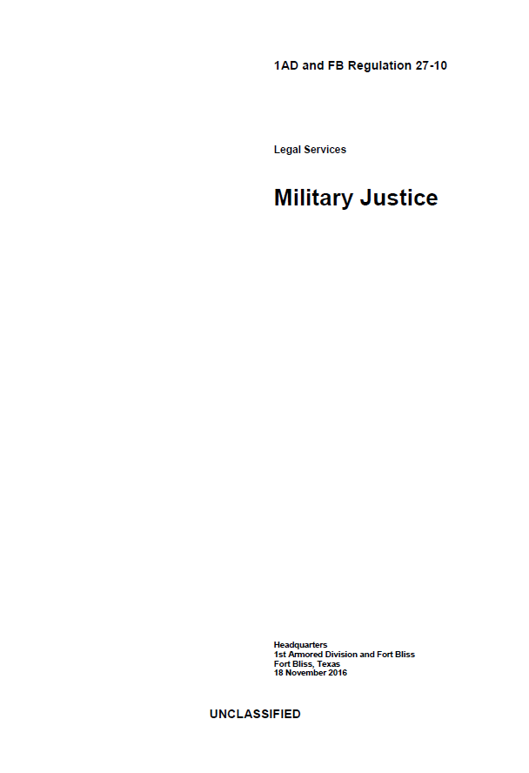
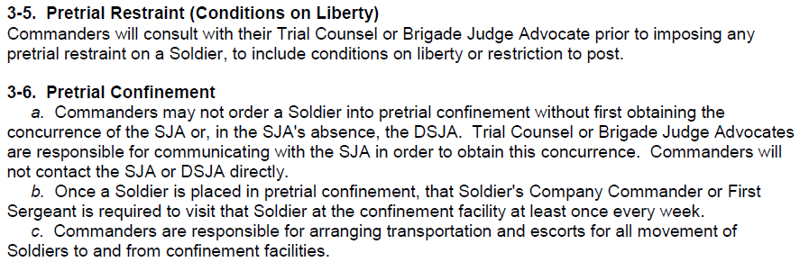

Slide 13
The PTC Process
SJA notified/ concurs
Trained escorts Identified
TDS counsel assigned
72-hour CDR’s review
Command visits
CDR wants to impose PTC
PTC Docs
Drafted
Charge sheet drafted
48-hour PC review
7-day MM review
Must provide DA Form 5112 (Checklist for Pretrial Confinement) to Military Magistrate NLT 36 hours following PTC.
AR 27-10, para. 8-5(b)(2)
Must complete DD Form 2707 (Confinement Order)
Check local resources for confinement facility requirements
Notes:
Local resources to check: go to PMO when you first become a TC and get their brief on what they need from the unit to intake someone into PTC
They’ll probably need things like packing lists, guard rosters, etc., signed by the CO CDR

Slide 14
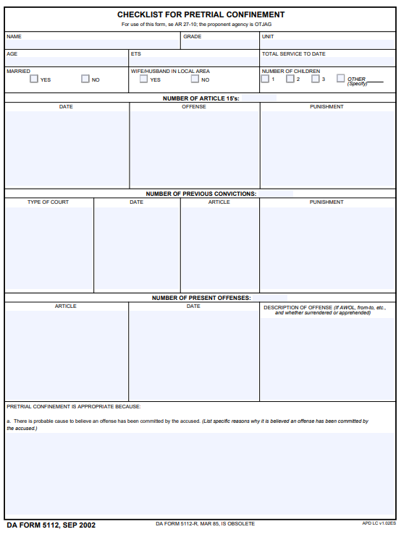
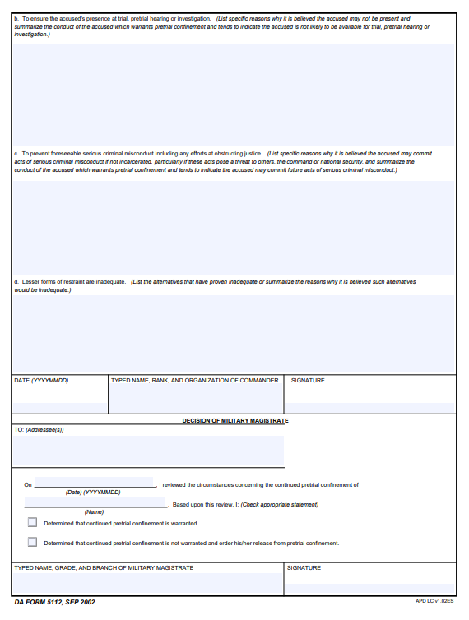

Slide 15
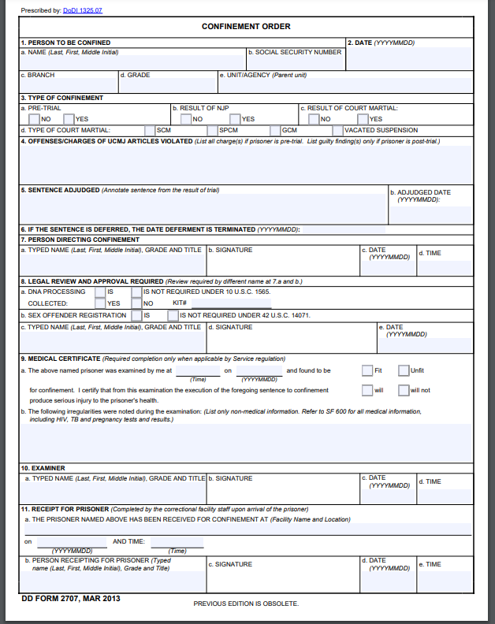

Slide 16
The PTC Process
SJA notified/ concurs
Trained escorts Identified
TDS counsel assigned
72-hour CDR’s review
Command visits
CDR wants to impose PTC
PTC Docs
Drafted
Charge sheet drafted
48-hour PC review
7-day MM review
Unit responsible for all movements of accused to/from confinement facility
Check local resources for confinement facility requirements for escorts/chasers
Notes:
Although your installation may have a qualified detention facility for PTC, you may be like the folks at FBNC, who have to send confines to Camp Lejeune
How it plays out: unit brings SM to Fort Bragg d-cell at PMO with proper paperwork
D-cell takes Accused
Unit has to leave guard force there to watch the guy in the cell (even though he is in a cell at PMO)
Typically can only stay at d-cell for 3 days max
After that, unit has to take Accused to Camp Lejeune (128 miles, 2h 17m with no traffic)
Unit has to pick up, drop off Accused for every visit, meeting with counsel, sanity boards, medical appointments, etc.
This is usually the first point at which the command say, “wait, I have to do what?”

Slide 17
The PTC Process
SJA notified/ concurs
Trained escorts Identified
TDS counsel assigned
72-hour CDR’s review
Command visits
CDR wants to impose PTC
PTC Docs
Drafted
Charge sheet drafted
48-hour PC review
7-day MM review
Except in extraordinary cases, a decision to prefer charges will be made within 7 days of confinement.
AR 27-10, para. 8-5(b)(2)
Notes:
BLATE: if you have PC to put someone in PTC, you have PTC to charge them with SOMETHING…just get something on the sheet and add additional charges later if required

Slide 18
The PTC Process
SJA notified/ concurs
Trained escorts Identified
OSTC & TDS coordination
72-hour CDR’s review
Command visits
CDR wants to impose PTC
PTC Docs
Drafted
Charge sheet drafted
48-hour PC review
7-day MM review
Military counsel (Defense Counsel) shall be provided to Accused prior to 48-hour PC review if requested. RCM 305(g)
Don’t Wait for request
If the commander orders confinement or releases for a covered offense the Special Trial Counsel shall be immediately notified. R.C.M. 305(h)
Notes:
RCM 305(f) requires that if Accused requests counsel and request made known to military authorities, military counsel must be provided before the 48-hour PC review or within 72 hours of request being communicated to military authorities (whichever occurs first)
How this usually works: if MJ shop and TDS have a positive relationship, MJ shop should give TDS a heads up that a confinement is coming before the person is even put in PTC…this way, TDS can make time to see the Accused immediately after he is placed in PTC

Slide 19
The PTC Process
SJA notified/ concurs
Trained escorts Identified
TDS counsel assigned
72-hour CDR’s review
Command visits
CDR wants to impose PTC
PTC Docs
Drafted
Charge sheet drafted
48-hour PC review
7-day MM review
Review of adequacy of PC to continue PTC—4 factors
RCM 305(j)(1)
Completed by neutral and detached officer within 48 hours
Notes:
Note that the 48 hour review has to happen within 48 hours of the Accused being ordered into PTC, but you don’t have to wait 48 hours

Slide 20
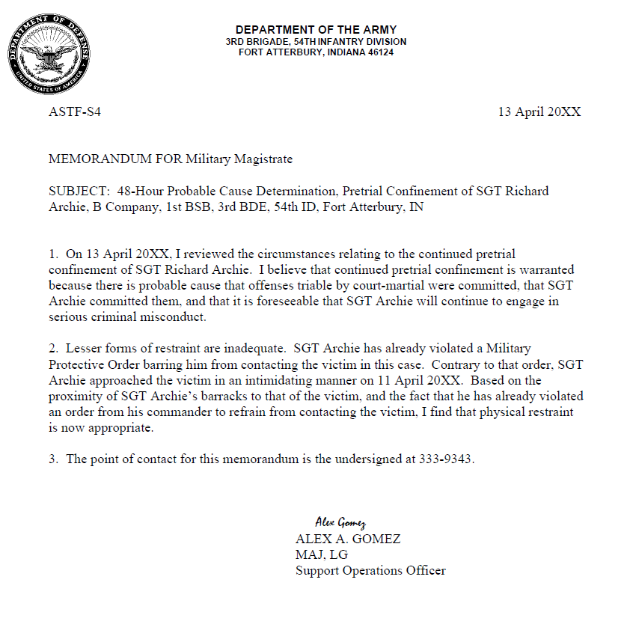

Slide 21
The PTC Process
SJA notified/ concurs
Trained escorts Identified
TDS counsel assigned
72-hour CDR’s review
Command visits
CDR wants to impose PTC
PTC Docs
Drafted
Charge sheet drafted
48-hour PC review
7-day MM review
CDR must decide in writing whether PTC will continue. RCM 305(i)(2)(C).
CDR can continue PTC based on Probable Cause that:
Offense triable by CM committed;
Accused committed it;
PTC necessary b/c foreseeable Accused will not appear, or will engage in serious criminal misconduct; AND
Less severe forms of restraint are inadequate
***Trial Counsel is drafting the 72-hour memo for CDR’s review!***
Notes:
Must happen within 72 hours of Accused being ordered into PTC, or report that a member of command has been put into PTC
But note that the CDR does not have to wait 72 hours…can do it contemporaneously with ordering PTC if he wants
This review can satisfy 48-hour PC review if CDR truly neutral and detached, and happens within 48 hours
Serious criminal misconduct includes intimidation of witnesses or other obstruction of justice, serious injury of others, or other offenses which pose a serious threat to the safety of the community or to the effectiveness, morale, discipline, readiness, or safety of the command, or to the national security of the United States. (RCM 305(h)(2)(B))
Commander should also consider the factors in the discussion to the rule
“[T]he ‘quitter’ who disobeys orders and refuses to perform duties” can have an “immensely adverse effect on morale and discipline, which, while intangible, can be more dangerous to a military unit than physical violence.” “[A]lthough the ‘pain in the neck’ [Soldier]... may not be confined before trial solely on that basis, the accused whose behavior is not merely an irritant to the commander, but is rather an infection in the unit may be so confined.” Analysis of Rules for Courts-Martial, MCM, p. A21-18 (pre-MJA).
United States v. Rosato, 29 M.J. 1052 (A.F.C.M.R. 1990), rev’d in part, 32 M.J. 93 (C.M.A. 1991). Accused who was willfully disobedient and disrespectful to superiors in the presence of 10-15 members of a student squadron was properly placed in pretrial confinement “to protect the unit’s discipline and morale from the accused’s disruptive behavior.” Unit consisted of new, junior personnel, accused had a history of disciplinary problems, student representatives complained about him, and the accused ignored first sergeant’s admonitions.
Although the Military Rules of Evidence are not applicable, the commander should judge the reliability of the information available.
Before relying on the reports of others, the commander must have a reasonable belief that the information is believable and has a factual basis.
The information may be received orally or in writing. Information need not be received under oath, but an oath may add to its reliability.
A commander may examine the prisoner’s personnel records, police records, and may consider the recommendations of others.
If continued pretrial confinement is approved, the commander shall prepare a written memorandum that states the reasons for the conclusion that the requirements for confinement in subsection (h)(2)(B) of this rule have been met. This memorandum may include hearsay and may incorporate by reference other documents, such as witness statements, investigative reports, or official records. This memorandum shall be forwarded to the 7-day reviewing officer (RCM 305(h)(2)(C)).

Slide 22
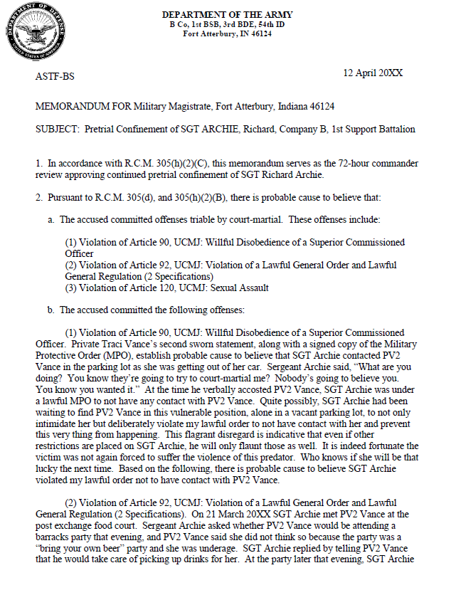
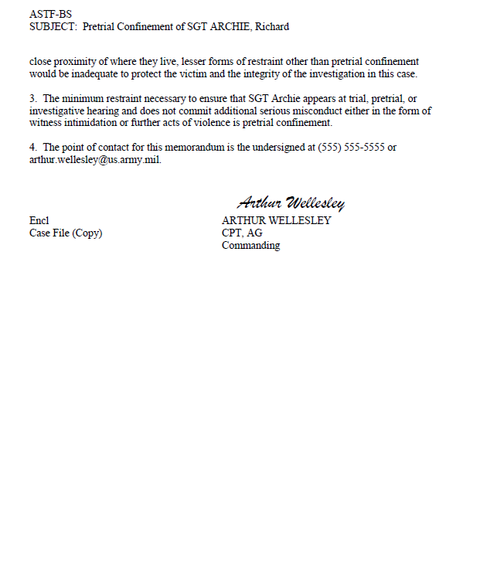

Slide 23
The PTC Process
SJA notified/ concurs
Trained escorts Identified
TDS counsel assigned
72-hour CDR’s review
Command visits
CDR wants to impose PTC
PTC Docs
Drafted
Charge sheet drafted
48-hour PC review
7-day MM review
Military Magistrate reviews PC determination and need for continued PTC. RCM 305(j)(2).
Occurs within 7 days; may extend to 10 days with good cause
The Government bears the burden by a preponderance of evidence
MREs generally don’t apply except privileges and 302/205
Accused and counsel must be allowed to appear and make a statement.
Remember to comply with requirements to notify the victim
Notes:
Military magistrate program established by AR 27-10, chapter 8
Army-wide program for review of PTC and issuance of search, seizure, and apprehension authorizations
MM is a JA appointed by TJAG/chief trial judge, chief circuit judges of Trial Judiciary under professional supervision of Trial Judiciary
Nominated by SJAs from outside of Crim Law shops
Initial date of confinement counts as one day and date of review counts as another day
Timeline for completion can be extended to 10 days for good cause
Preponderance of evidence = more likely than not
TC has responsibility for providing the documents listed to both the MM and DC…provide them as soon as they are available!
Accused, DC, and TC should be allowed to make statements
This is a review…not an adversarial hearing; the MM has full control of the scope of the review, but should not allow it to become akin to a CM
No courtroom and no robes
No guards in the room unless absolutely required
GOV/DEF should not be allowed to call Ws, although MM can consider W testimony if he wants (should be the exception!)
MM can ask the GOV for more information if he wants
MM and TC should not question the Accused, although Accused can make a statement
MRE do not apply except for privileges, MRE 302, and MRE 305
MM can reconsider decision to continue PTC based on significant information not previously considered
Once charges referred, MJ can review continued PTC through motion for appropriate relief (RCM 305(j); RCM 906(b)(8))
MJ shall order release from PTC only if MM’s decision was an abuse of discretion and there is not sufficient info presented to the MJ justifying continued PTC, new information justifying release is presented to the MM, or proper 305 procedure not complied with and info presented to the MJ does not establish sufficient grounds for continued PTC
Once released from PTC, Accused cannot be put back in unless new evidence or misconduct occurs that either alone or ICW the other available evidence justifies PTC
CDR can order any lesser forms of restraint he feels necessary under the circumstances…MM cannot order lesser forms of restraint
QUESTION: Note that the slide says Accused can choose not to attend review although MM must still conduct the review…can you think of some reasons why an Accused may want to not contest PTC?
Everyone might just know it’s a lost cause
If the Accused is in PTC, they will keep getting paid while getting credit against their sentence
If the Accused is in PTC, he can’t do more stupid things
Victim’s (person who has suffered direct physical emotional, or pecuniary harm as a result of commission of a UCMJ offense) rights: notice of the 7-day review; right to confer with representative of the command and counsel for the government; right to be reasonably heard during the review; right to notice of MM ordering release from PTC, right to notice of a motion for appropriate relief to MJ, notice of escape
Hearing may not be unduly delayed for this purpose.
Personal appearance not required (phone, VTC, written statement, counsel)
Right to be heard under this rule includes the right to be heard through counsel and the right to be reasonably protected from the prisoner during the 7-day review.
17–14. Notification and description of services provided to victims of crime
a. During the investigation and prosecution of a crime, the trial counsel or special trial counsel will en-sure that the victim (through, or in coordination with, the SVC, when applicable) is provided the earliest possible notice of significant events in the case, to include—
(1) The status of the investigation of the crime, to the extent that it will not interfere with the conduct of the investigation, the rights of the accused, or the rights of other victims or witnesses.
(2) The apprehension of the suspected offender.
(4) The initial appearance of the suspected offender before a judicial officer at a pretrial confinement hearing or at a preliminary hearing under UCMJ, Article 32.

Slide 24
Victim Rights
Victim must receive notice, right to confer & has right to be reasonably heard at the PTC Hearing!
Article 6b and AR 27-10 para. 17-14.
Personal appearance by victim not required, right to be heard may be accomplished telephonically, or through counsel.
Notification of the release or escape of the accused, unless the notification endangers the safety of any person.
Article 6b(a)(4)(A).

Slide 25
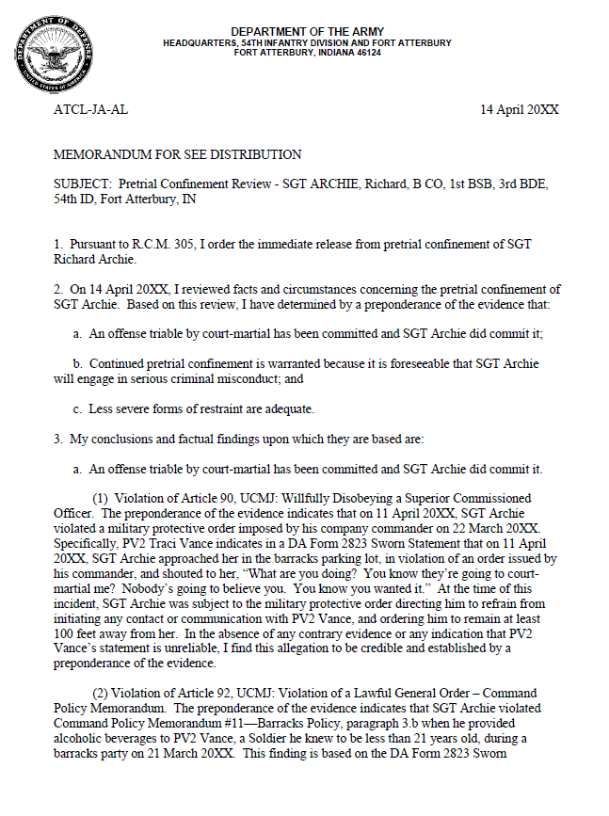
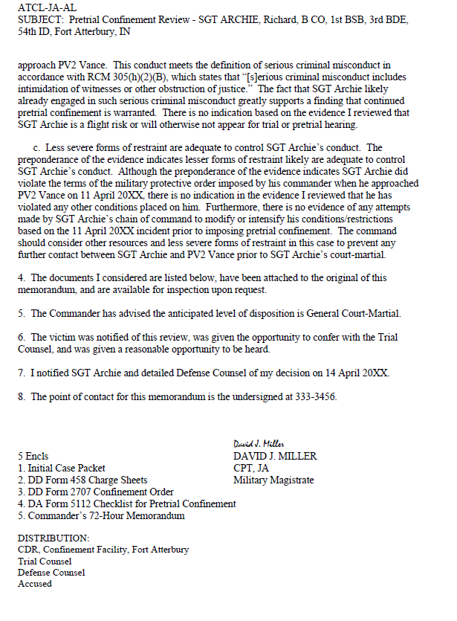

Slide 26
The PTC Process
SJA notified/ concurs
Trained escorts Identified
TDS counsel assigned
72-hour CDR’s review
7-day MM review
CDR wants to impose PTC
PTC Docs
Drafted
Charge sheet drafted
48-hour PC review
Command visits
Local 27-10 supplement may have CMD visitation requirements
Unit is responsible for all movements of accused to/from confinement facility
Meetings with TDS
Arraignment
Pretrial hearings
Trial
Notes:
Recall before when we discussed that at FBNC, all PTC folks go to Camp Lejeune for their confinement, more than 2 hours away…this means that for every one of the events listed, the CMD is responsible for getting the SM to/from Lejeune (about 5 hours burned per trip for that team)
And once a month, the CDR or his rep have to make the 5 hours roundtrip themselves

Slide 27
Main Takeaways
Restrictions on Liberty can result in sentencing credit.
PTC is the most severe restriction and requires neutral probable cause determinations and triggers command responsibilities.
Command is still responsible for welfare checks on the Soldier while in confinement.
You cannot impose PTC unless you have drafted charges or intend on preferring charges!

Slide 28
Questions?

Slide 29
Need Training Materials?
Have Training Materials?
Questions?
Contact Us!
TJAGLCS-training@army.mil

